Slide 1
To-do June/July
Compare multiplicative return vs. logarithmic return
Per period
Adjusted to annual
Include smoothed prices or smoothed returns vs. raw prices (3 day centered moving average, 5 day centered mov avg)
Implement minimum number of steps from min variance to Max Sharpe iteration for frontier
Consider how to handle max number of steps situation
Implement top N of M frontier analysis
Individual analysis function
Composite analysis (list?) and display of results
Consider how PowerBI might play a role
Refactor functions as part of the above improvements
Longer term:
Find some way to look at ‘momentum’ periods for assets (i.e,. How long does a higher return period last. Or how long do they stay in the top xx of return givers. It would be really nice to not swap out the top xx assets all the time.

Slide 2
Multiplicative vs. Logarithmic Returns / Daily vs. Annualized Processing / Raw Daily Prices vs. Filtered
Fully Processed
Annualized
Annualized Daily
Fully Processed Daily
Raw
Daily
Data
Annualized
Results
Goal:
Report all charts and tables in annualized equivalent returns or volatilities to allow comparisons to common industry results and literature.
Minimize any mathematical noise introduced with the additional processing.
Options – Two Facets:
A: multiplicative daily multiplier (division) vs. logarithmic daily difference
B: when to convert data to annualized values –
At the start of the processing (daily returns immediately converted to annualized values)
At the end of all other processing (efficient frontier points, Sharpe portfolio values, etc.)
Or, somewhere in between
Four potential paths (high level):
Paths 2 and 4 should (theoretically) have more numerical noise than 1 and 3, respectively. (Don’t amplify noise before doing the major processing.)
Path 3 should have less numerical noise than 1, as multiplicative returns geometrically grow noise but logarithmic returns only linearly grow noise.
Focus further comparisons on Path 1 vs. Path 3.
Filtering high frequency (daily) variations from Daily Raw Prices may help further with numerical noise.
2
4
1
3
Raw Price
Filtered Price
Multiplicative
Multiplier
Logarithmic Diff Return

Slide 3
Converting Daily Returns / Volatility to Annualized
By convention, assume 252 trading days per calendar year.
Multiplicative daily data:
Daily Multiplier = Price (today) / Price (yesterday)
Daily Return = Daily Multiplier – 1.0
Annual Multiplier = (Daily Multiplier)^252
Annual Return = Annual Multiplier – 1.0
Logarithmic Difference daily data:
Daily Log Difference = Log10(Price(today)) – Log10(Price(yesterday))
Daily Multiplier = 10^(Daily Log Difference)
Daily Return = Daily Multiplier – 1.0
Annual Log Difference = (Daily Log Difference)*252
Annual Multiplier = 10^(Annual Log Difference)
Annual Return = Annual Multiplier – 1.0
Three processing paths to analyze (not two per prior slide):
(new) Daily Return (DR) > Eff Frontier > Selected Portfolio > Scale results to Annualized Return
(1) Daily Multiplier (DM) > Eff Frontier > Selected Portfolio > Scale results to Annualized Return (AR)
(3) Daily Log Difference > Eff Frontier > Selected Portfolio > Scale results to AR
Scaling Results to Annualized Return (AR):
(new) Daily Return -> AR: AR = (DR + 1)^252 – 1.0
(1) Daily Multiplier (DM) -> AR: AR = DM^252 -1.0
(3) Daily Log Diff (DLD) -> AR: AR = 10^(DLD*252) – 1.0
Apply scaling to:
Asset and Portfolio Expected Returns
Asset and Portfolio Std Deviations (or volatility)

Slide 4
Processing Tree: Factor Breakdown
Multi-Scenario Analysis (main loop):
Stages multiple Eff Frontier Calcs
Summarize/Prep Price Data (once for each calculation approach):
Native Expected Returns, Std Dev, Covariances
Scale Results (inner short cut):
Scales results to desired output (native, annualized, or both)
Don’t re-calculate results just to re-scale.
Calculate Efficient Frontier:
Calculates a single efficient frontier given a set of inputs. No charts are created.
GraphStuff:
Graphs result singly or in aggregate as tailored.
Potential Scenario Factors:
**TopN
**Shorting/Not
**Risk Free Asset return
**nPoints for ExpReturns, Covar (or other method parameters)
**Calc Approach (Return, Multiplier, Log Diff)
**Output Scaling (Native, Annualized)
##Input Data Period (daily, monthly, etc.)
** vectors of factors for scenarios
## input parameter (single value)
Issues:
Can’t commonize Native output scenarios, but Can communize Annualized output scenarios.
Design Decision:
Make all scenario factors part of single Main Loop.
Scale results as specified in ‘inner short cut’.
Append results for all scenarios processed.

Slide 5
Processing Tree: Loop Structure, List Structure
Load data
Loop Scenarios:
Loop smoothing
Loop Calc approach:
Summarize Input data
Loop Scale Results
Loop most Factors (TopN, Shorting/Not, etc.)
Calc Efficient Frontier
Loop Scale results
Append results to List
Create Charts from List of Outputs
Output List Structure:
$Inputs (List):
Factor vectors – named
Inputs – named
$PriceNormRaw, $PriceNormSmooth,
$CalcApproach (List named – Return, Multiplier, Log Diff)
$Summary (List named – Native, Annualized)
$ExpReturn, $ExpStdDev, $CorrelToTopRet
$Covar
$RiskFree
$Results (List – Factor combinations – index only, no names
$FactorCombo (List – named)
$eff – efficient frontier
$Sharpe – max Sharpe ratio point of efficient frontier
$Scale – “Native” or “Annualized Return”
Design Decision:
Make all scenario factors part of single Main Loop.
Scale results as specified in ‘inner short cut’.
Append results for all scenarios processed.

Slide 6
Processing Tree / Function Tree
Calculate Efficient Frontier:
Calculates a single efficient frontier given a set of inputs. No charts are created.
Inputs: asset returns & covariances, risk free return, max allocation limit, shorting flag, parameters for frontier
Outputs: frontier points with portfolio mix and stats, maximum Sharpe Ratio point
Works for any units of input parameters: daily returns, daily multipliers, daily log differences, monthly data, etc.
Summarize / Prep Price Data:
Inputs: stacked price data, price data units, scaling of results, [parameters for expected return, covariance]
Outputs: tables scaled results
Expected returns/std deviations,
Covariance, etc., scaled
Multi-Frontier Analysis:
Stages multiple efficient frontier calculations and collects the results. No charts are created.
Inputs:
Stacked price data, Price data units (daily, monthly), Risk free asset returns to use (annualized return)
vectors of [TopN assets], [Shorting flag values], [calculation approaches (DR, DM, DLD, monthly, etc.)], [scaling of results (native, annualized)], [sets of ExpRet / Covar nPoints], [smoothing factors for price data]
Outputs: list of lists
For each analysis scenario - List of frontier points, max Sharpe point, scenario parameters

Slide 7
Relative Price
Smoothed: n= 1 (raw), 3, 5, 21
Center moving average – no time shift

Slide 8
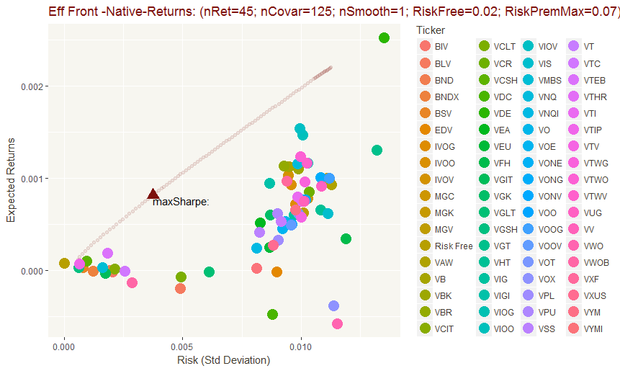
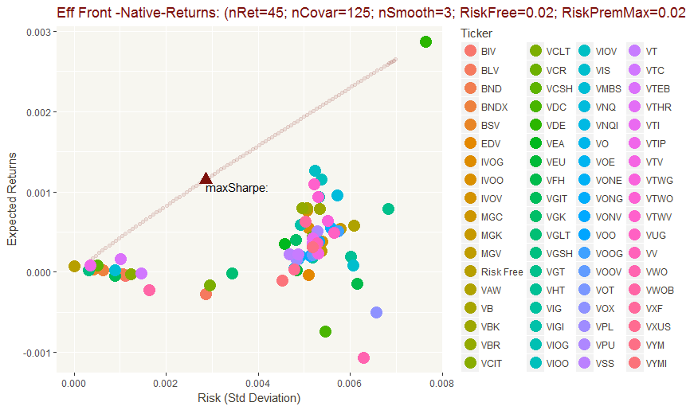
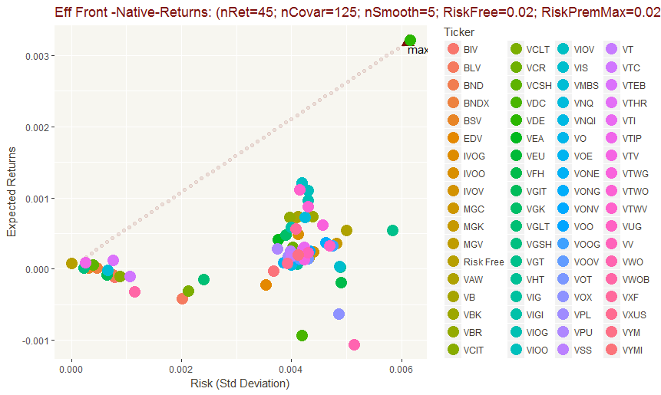
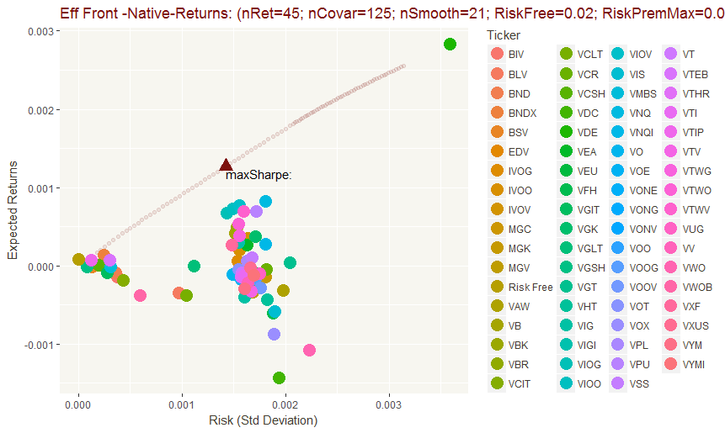
Eff Frontier
Arithmetic Returns
Native
Smoothed: n= 1 (raw), 3, 5, 21
Center moving average – no time shift

Slide 9
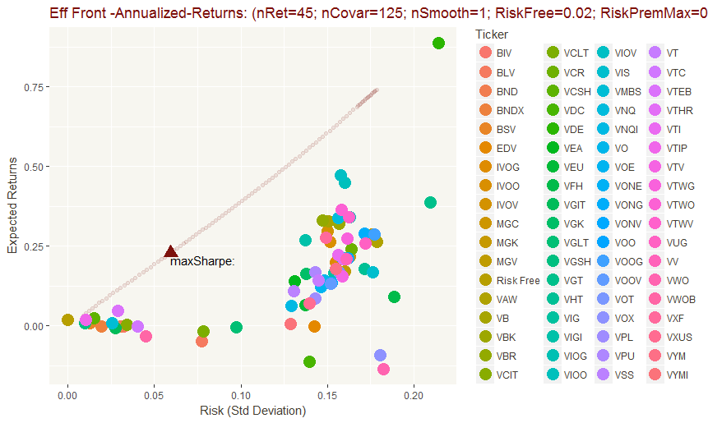
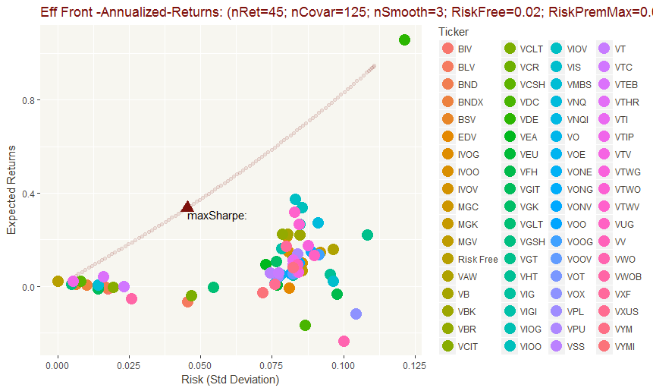
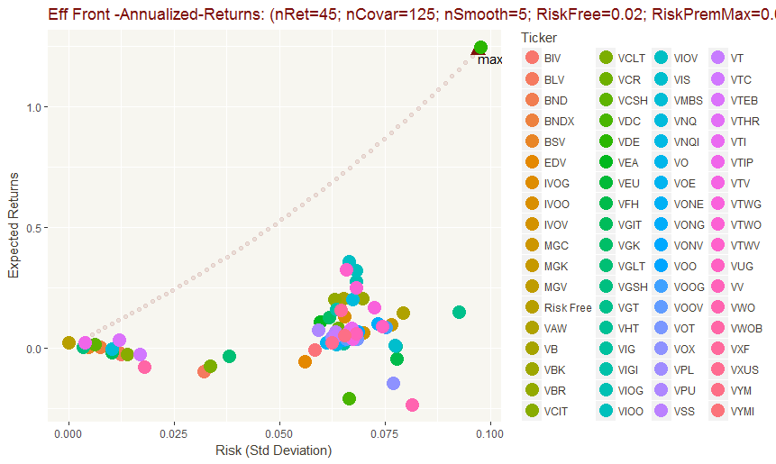
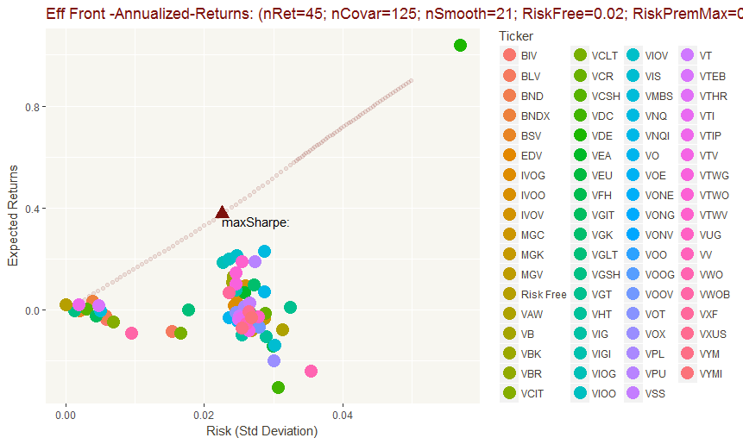
Eff Frontier
Arithmetic Returns
Annualized
Smoothed: n= 1 (raw), 3, 5, 21
Center moving average – no time shift

Slide 10
Portfolio
Arithmetic Return
Smoothed: n= 1 (raw), 3, 5, 21
Center moving average – no time shift

Slide 11
Portfolio vs IDX Clean
Arithmetic Return
Smoothed: n= 1 (raw), 3, 5, 21
Center moving average – no time shift

Slide 12
Portfolio vs Annual Std.Dev Clean
Arithmetic Return
Smoothed: n= 1 (raw), 3, 5, 21
Center moving average – no time shift

Slide 13
Sharpe vs. Risk
Arithmetic Return
Annualized
Smoothed: n= 1 (raw), 3, 5, 21
Center moving average – no time shift

Slide 14



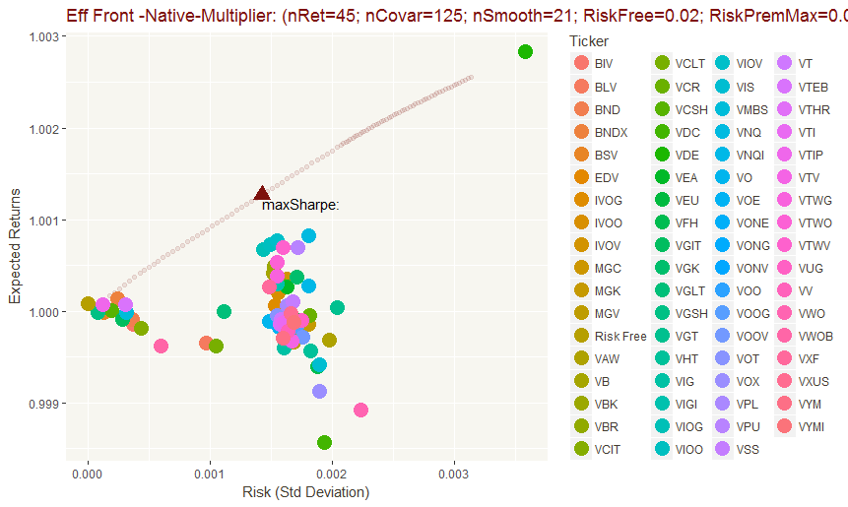
Eff Frontier
Arithmetic Multiplier
Native
Smoothed: n= 1 (raw), 3, 5, 21
Center moving average – no time shift

Slide 15




Eff Frontier
Arithmetic Multiplier
Annualized
Smoothed: n= 1 (raw), 3, 5, 21
Center moving average – no time shift

Slide 16
Portfolio
Arithmetic Multiplier
Smoothed: n= 1 (raw), 3, 5, 21
Center moving average – no time shift

Slide 17
Portfolio vs IDX Clean
Arithmetic Multiplier
Smoothed: n= 1 (raw), 3, 5, 21
Center moving average – no time shift

Slide 18
Portfolio vs Annual Std.Dev Clean
Arithmetic Multiplier
Smoothed: n= 1 (raw), 3, 5, 21
Center moving average – no time shift

Slide 19
Sharpe vs. Risk
Arithmetic Multiplier
Annualized
Smoothed: n= 1 (raw), 3, 5, 21
Center moving average – no time shift

Slide 20
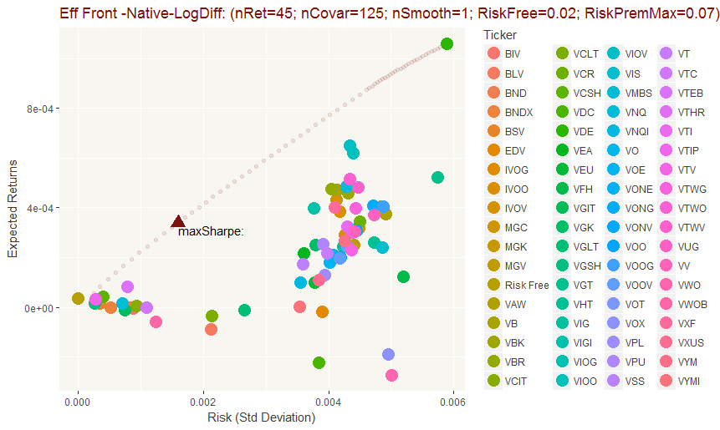

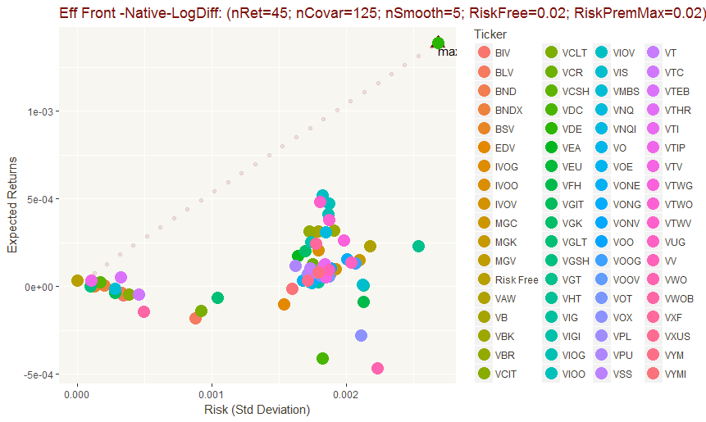

Eff Frontier
Log Diff Returns
Native
Smoothed: n= 1 (raw), 3, 5, 21
Center moving average – no time shift

Slide 21
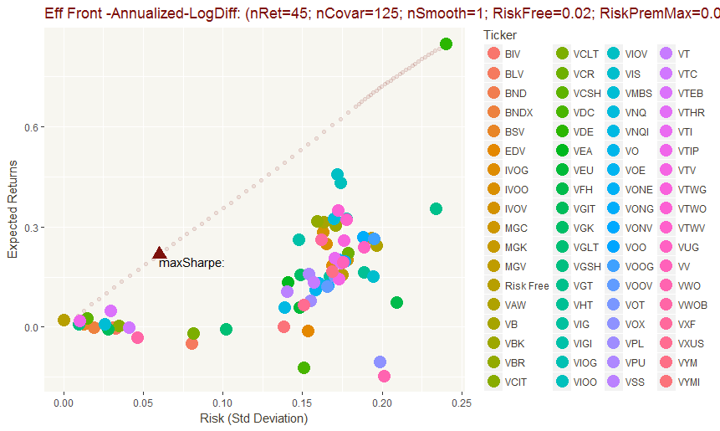

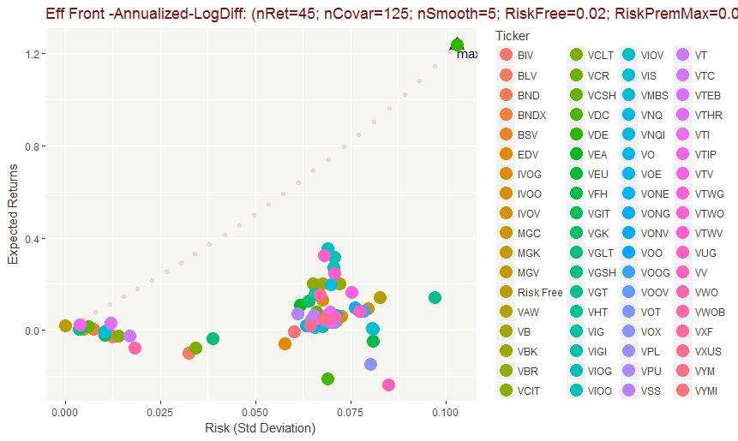

Eff Frontier
Log Diff Returns
Annualized
Smoothed: n= 1 (raw), 3, 5, 21
Center moving average – no time shift

Slide 22
Portfolio
Log Diff
Smoothed: n= 1 (raw), 3, 5, 21
Center moving average – no time shift

Slide 23
Portfolio vs IDX Clean
Log Diff
Smoothed: n= 1 (raw), 3, 5, 21
Center moving average – no time shift

Slide 24
Portfolio vs Annual Std.Dev Clean
Log Diff
Smoothed: n= 1 (raw), 3, 5, 21
Center moving average – no time shift

Slide 25
Sharpe vs. Risk
Log Diff
Annualized
Smoothed: n= 1 (raw), 3, 5, 21
Center moving average – no time shift

Slide 26
Method Comparisons
Annualized Frontier
Smooth 3

Slide 27
Method Comparisons
Portfolio
Smooth 3

Slide 28
Method Comparisons
Portfolio vs IDX Clean
Smooth 3

Slide 29
Method Comparisons
Portfolio vs Annual Std.Dev Clean
Smooth 3

Slide 30
Method Comparisons
Sharpe vs. Risk
Smooth 3

Slide 31
Comparisons
Smoothed Price: n= 1 (raw), 3, 5
Center moving average – no time shift

Slide 32
Comparisons
Smoothed Price: 1, center moving average filter
Methods: Daily Return, Daily Multiplier, Daily Log Difference
Converted to Annualized Return, Annualized Std Deviation

Slide 33
Comparisons
Smoothed Price: 3, center moving average filter
Methods: Daily Return, Daily Multiplier, Daily Log Difference
Converted to Annualized Return, Annualized Std Deviation

Slide 34
Comparisons
Smoothed Price: 5, center moving average filter
Methods: Daily Return, Daily Multiplier, Daily Log Difference
Converted to Annualized Return, Annualized Std Deviation

Slide 35
Comparisons
Smoothed Price: 21, center moving average filter
Methods: Daily Return, Daily Multiplier, Daily Log Difference
Converted to Annualized Return, Annualized Std Deviation

Slide 36
Dynamic Asset Management – Update May 2018

Slide 37
Approach
Update daily asset price data
Use barchart.com (free API) with Excel/VBA
Screen updated asset price data to identify top candidates for next investment period.
Use PowerBI, R, Rstudio for screening and evaluation.
Should consider various methods to estimate *future* return, not just rely on historical returns of various periods (future)
Current code allows using different lengths of samples for Expected Returns, and for calculating Asset Covariances
Calculate efficient frontiers (shorting and no-shorting), including:
Portfolios along the efficient frontiers,
Maximum Sharpe ratio points and corresponding portfolios
Use R / Rstudio to solve for points/portfolios on an efficient frontier
Repeat screening and calculating frontiers until happy.

Slide 38
Example 1: 2000-2016 Monthly Price Data for IBM, JPM, GOOG
Data from: ??
Parameters:
12 samples (1 year) for expected return
60 samples (5 years) for covariance
Screening (so far):
Relative Price chart – indexed to most recent data value
Return / Risk chart of individual assets
Correlation heatmap – (still a work in progress)
Efficient Frontiers and Portfolios
Two cases: “Shorting Allowed” and “No Shorting”
Code allows using different lengths of samples for Expected Returns, and for calculating Asset Covariances

Slide 39
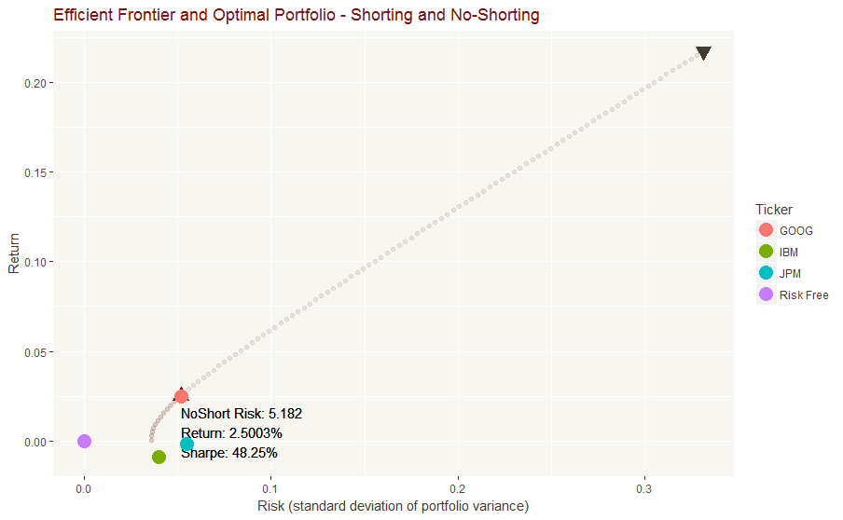
Example 1: Charts

Slide 40
Example 1: Charts

Slide 41
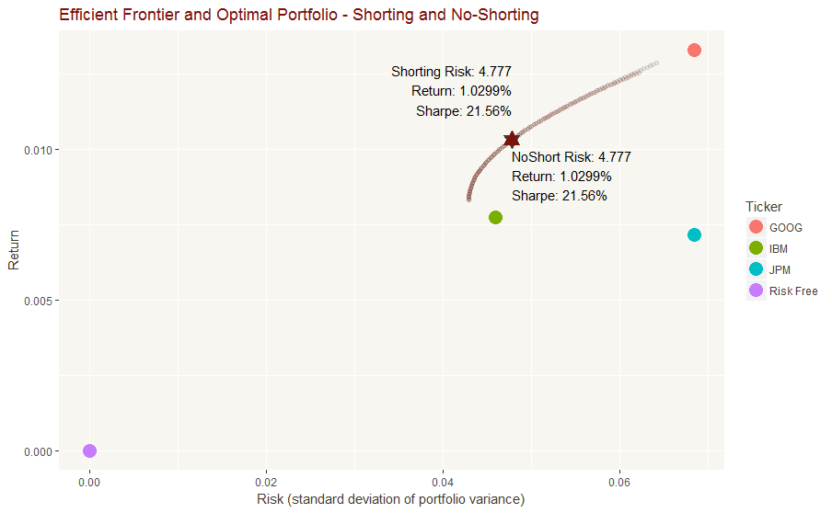
Example 2 – same data – 10 yrs/10yrs

Slide 42
Example 2 – same data – 10 yrs/10yrs

Slide 43
Software needed
Excel / VBA: used to download data from barchart.com
R: language for data analysis and stats - https://www.r-project.org/
Rstudio: development environment for R - https://www.rstudio.com/products/rstudio/download/
PowerBI desktop: eventually to be used for screening - https://powerbi.microsoft.com/en-us/downloads/

Slide 44
Additional Functionality Needed
Quickly screen and down-select the pool of assets
Quickly evaluation different frontiers and adjust range of analysis parameters or step increments (risk increment, max risk)
Alternative estimates of future return
Evaluate approaches with accuracy & bias of 1 month (or 1 refresh period) future forecast.
Evaluate stability and range of covariance between selected pairs.
Better graphical summary of max Sharpe portfolios
Calculate rebalancing trades needed from current portfolio to selected future portfolio weights.
Confirm if fewer assets makes more stable frontiers/portfolios, or if numerical calculations are so stable they don’t care. This will shape how much manual ‘screening’ and ‘down-selection’ is needed (vs. just ‘fun-to-do’)
Understand a little more about why certain assets were selected in the ‘many similar assets’ scenario.

Slide 45
Next Steps
Tim to download R, Rstudio.
Tom to share:
Excel/VBA file (cleaned-up version)
Rstudio project, with related scripts. Only include small sample data sets.

